Slide 1


Duke Plasto Technique Private Limited
“FIT TO JOB”
Digital Human Resource System

Slide 2
“FIT TO JOB”
Why? - “FIT TO JOB”
Current system is Manual, Lengthy, Time Taking and Incompetent
Confidence of current manual system?
Right candidate? Right Job?
How find right candidate? Evaluation system?
Data management tool not available and evaluation system not done in within time.
New candidate data bank not available.
Some time wrong selection in urgency.
Cannot justify of qualified candidate in interview
Justification of employees are FIT TO JOB or Not?

Slide 3
“FIT TO JOB”
Why? - “FIT TO JOB”
Some time cannot give an opportunity to an eligible employee.
Cannot be replaced, if the employee is not FIT TO JOB.
It is not known what kind of training an employees need.
Cannot able to set training plan and gape analysis.
Employee growth plan?
Self reliable employee?
Management question?
Hidden cost.

Slide 4
“FIT TO JOB”
Self Reliable Employees
Can decide their own growth plan.
Should take training himself.
Should be responsible for Multi Skill himself.
Can improve their own productivity.
All data available in softcopy. Employees can take training in his free time.
Dependant moves to Independent

Slide 5
“FIT TO JOB”
Hidden Cost
Time consume in unnecessary interviews
New employee cannot recruit in JIT
Opportunity loss.
Productivity loss. If not available right time right employee
Data not available when needed
Right candidate not select due to lot of candidate

Slide 6
“FIT TO JOB”
How to Use Data
Area wise, Distance wise, Qualifications wise data filter
Skilled and unskilled employee
Find eligible employee
Present employee background data for promotions
Manual data management remove, HR 5S
Unique ability wise job offer
Interchange option
Find area wise qualified candidate

Slide 7
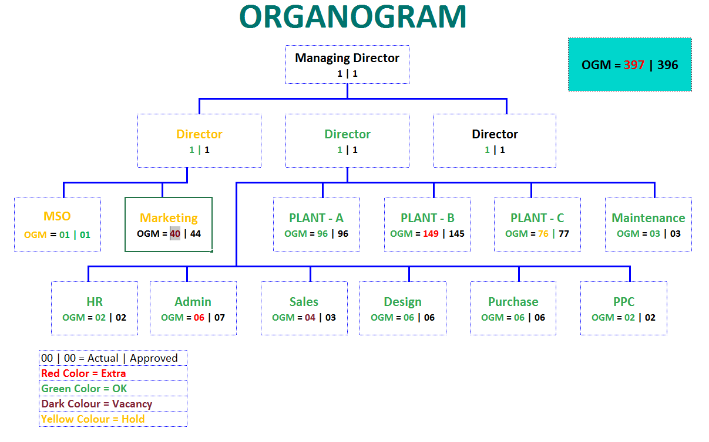
Digital Human Resource System “FIT TO JOB”

Slide 8
Digital Human Resource System “FIT TO JOB”
VACANCY

Slide 9
Digital Human Resource System “FIT TO JOB”
EXTRA

Slide 10
Digital Human Resource System “FIT TO JOB”
HOLD

Slide 11

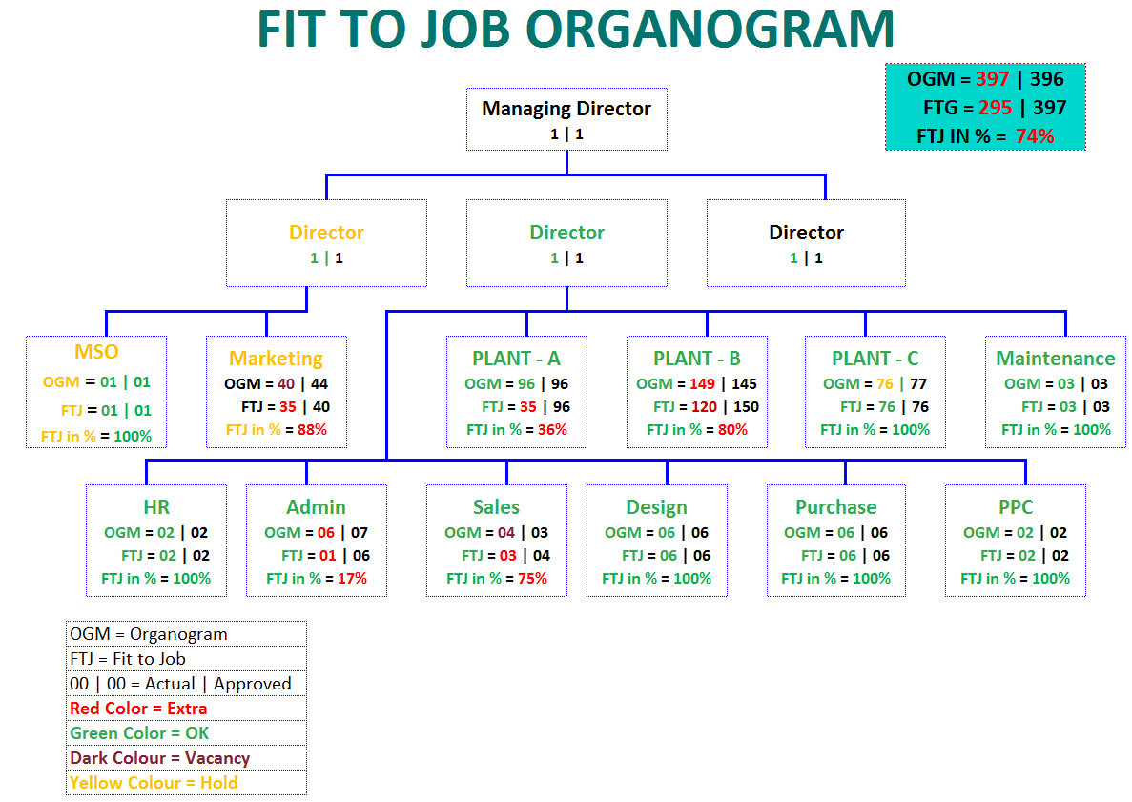
Digital Human Resource System “FIT TO JOB”

Slide 12
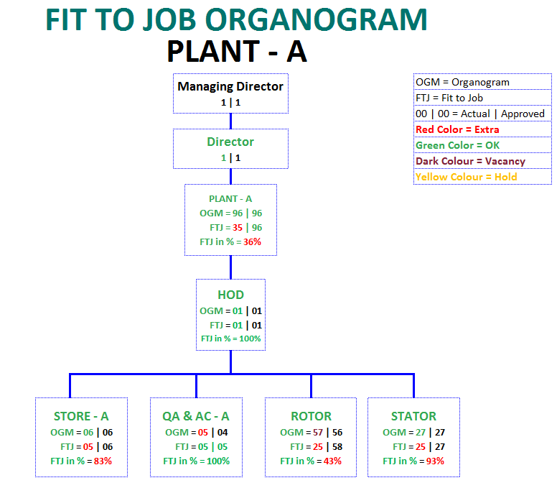
Digital Human Resource System “FIT TO JOB”

Slide 13
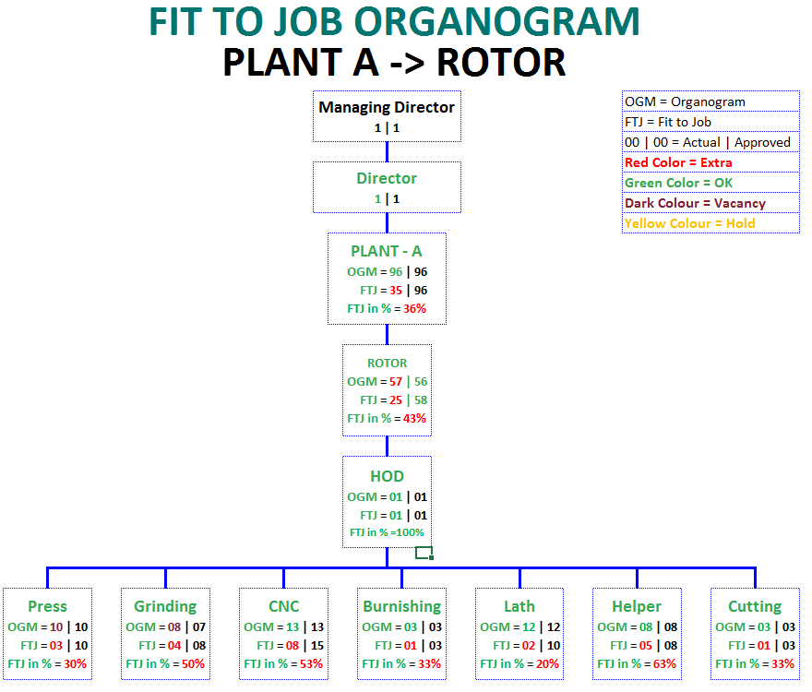
Digital Human Resource System “FIT TO JOB”

Slide 14
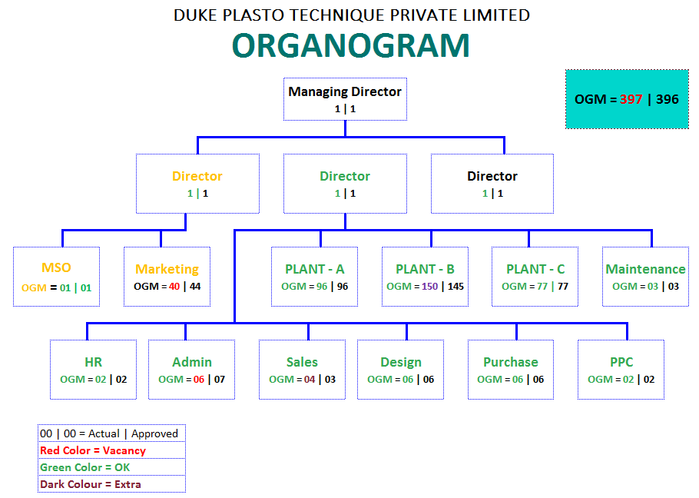
Digital Human Resource System “FIT TO JOB”
GENERATE
VACANCY

Slide 15
Digital Human Resource System “FIT TO JOB”
Vacancy
GENERATE
VACANCY
Against Organogram
Special Requirement
Internal
Out Side
Show List
From Promotion Exam Passed Employee
Interview Passed Hold Candidate List
New Interview List

Slide 16
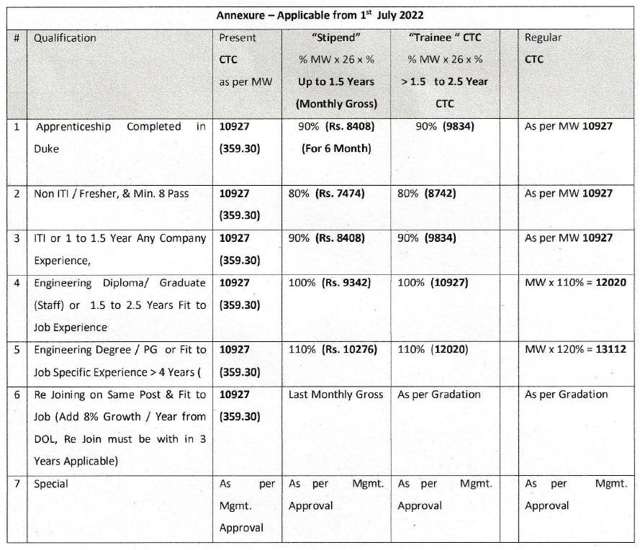
Growth Plan

Slide 17
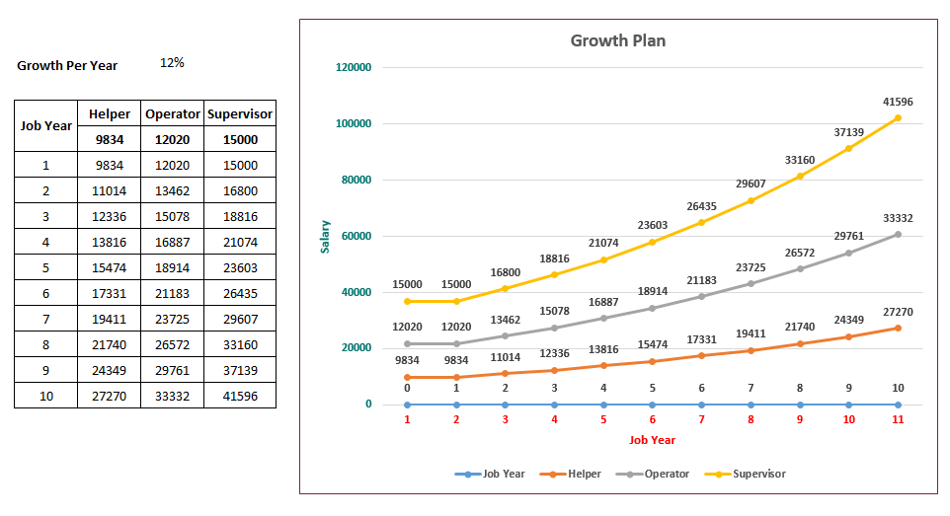
Growth Plan

Slide 18
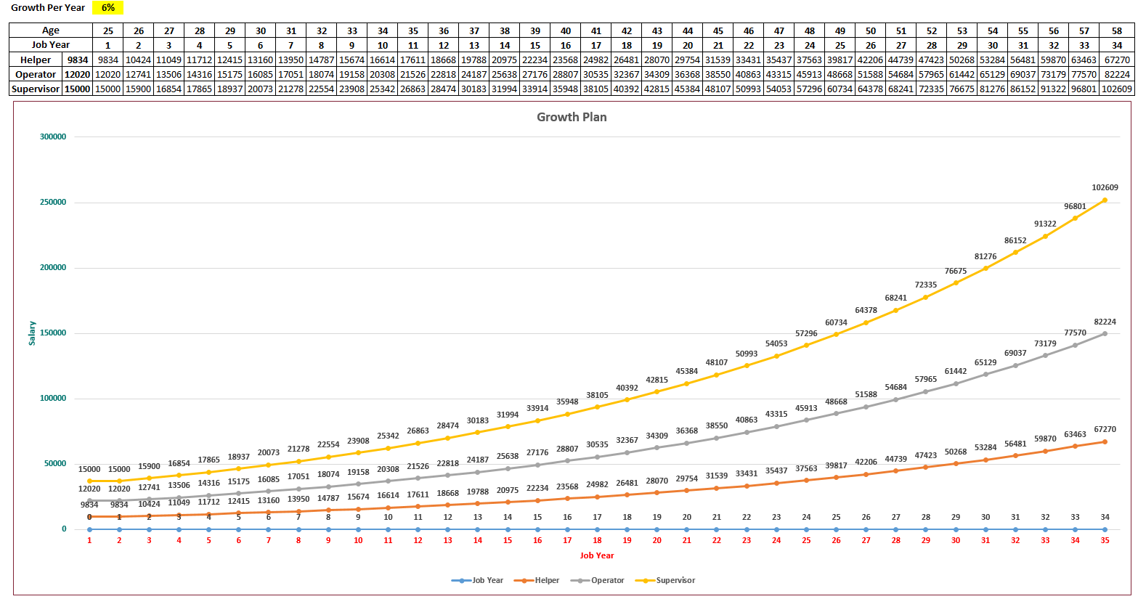
Growth Plan

Slide 19
Duke Plasto Technique Private Limited
New Employee
Digital Human Resource System
“FIT TO JOB”

Slide 20






Digital Human Resource System “FIT TO JOB”
Flowchart
Online Application
Fill-up Interview Form Details
Basic Exam MCQ
Video Interview
Job Offer
3 Days Training
HR Training
Rules and Regulations
Work Instruction
Initial selection
Data filter as per requirement
Select candidate
Call latter for interview
Second interview
By HOD / Management
Practical Exam
Job profile question answer
First interview by HR
Data Verification
Document Verification

Slide 21

Digital Human Resource System “FIT TO JOB”
Online Application medium
Kiosk
Kiosk will be available Duke Gate
Employees who are less familiar with digital technology will use this tool (Like- Production employee)
Candidate can submit interview
Gate keeper will help to candidates
Training will be provided to gate keepers as per requirement

Slide 22

Digital Human Resource System “FIT TO JOB”
Online Application
Kiosk
Mobile
Share link to Duke employee’s group, LinkedIn and collages for fresher
First show help video of how to give interview

Slide 23

Digital Human Resource System “FIT TO JOB”
Online Application
Kiosk
Set link to Duke Website with Blink and with slogan of
Mobile
Website

Slide 24
Digital Human Resource System “FIT TO JOB”
Online Application
Kiosk
Set link to Duke Website with Blink and with slogan of
(Data will store in ERP server)
show help video of how to give interview
Mobile
“Build a career with Duke team” (“કેરીયર બનાવો ડયુક ટીમ સાથે”)
Website

Slide 25
Digital Human Resource System “FIT TO JOB”
Interview Details
Fill-up Basic Details
Aadahar No.:-
Language Option Available
Gujarati
Hindi
English
8034 XXXX 8034
Your Name:-
Irshad
Father Name:-
Yusuf
Surname:-
Mansiya
Village / City :-
Chadotar
Taluka:-
Palanpur
District:-
Banaskantha
State:-
Gujarat
Address :-
NH. 27 Deesa Highway, Behind Iqra English medium school Chadotar
Submit
Login with OTP

Slide 26




Interview Details
Select Job Profile
State GM Leader
Executive
Ask for Which Area
Marketing Staff
Security
Canteen
Sweeper
Utility Staff
Select Job Profile
Purchaser
Accountant
Design
System
IT
HR
Admin
PPC
Office Staff
Production Leader
Winder
Fitter
Helper
Store Keeper
QC inspector
Welder
CNC Operator
Lath Operator
Press Operator
Production Staff
Note :- Multiple job profile selection option and show all job profile

Slide 27




Interview Details
Exam Test
Easy Question
Medium Question
Hard Question
Challenging Question

Slide 28
Interview Details
Exam Test
“Congratulations”
You are completed First Level
For next level click on “Next”
“Congratulations”
You are completed First Level
For next level click on “Next”
“Congratulations”
You are completed First Level
For next level click on “Next”
Easy Question
MCQ type question
Photo selection option
Skip option available
Each question with timer
Each level five question only
Show Result to Candidate
Re-Exam option available
If pass then allow for next stap.

Slide 29


Interview Details
Self Introduction
Demo
Record Self Introduction
Objective
To check candidate body language
To Check Fitness
To Check Word delivery
Only 10 to 20 Second Video allow
Capture Candidate Photo
Capture Candidate Self Introduction

Slide 30

Interview Details
Upload Resume
Submit
Upload Resume

Slide 31
Interview Details
Fill-up Interview Form Data
Decide Mandatory and Optional Data
Fill-up interview form data
Submit

Slide 32

Digital Human Resource System “FIT TO JOB”
Initial Selection
Level 1 = 05 | 05
Level 2 = 04 | 05
Level 3 = 03 | 05
Level 4 = 01 | 05

Slide 33
Digital Human Resource System “FIT TO JOB”
Initial Selection

Slide 34
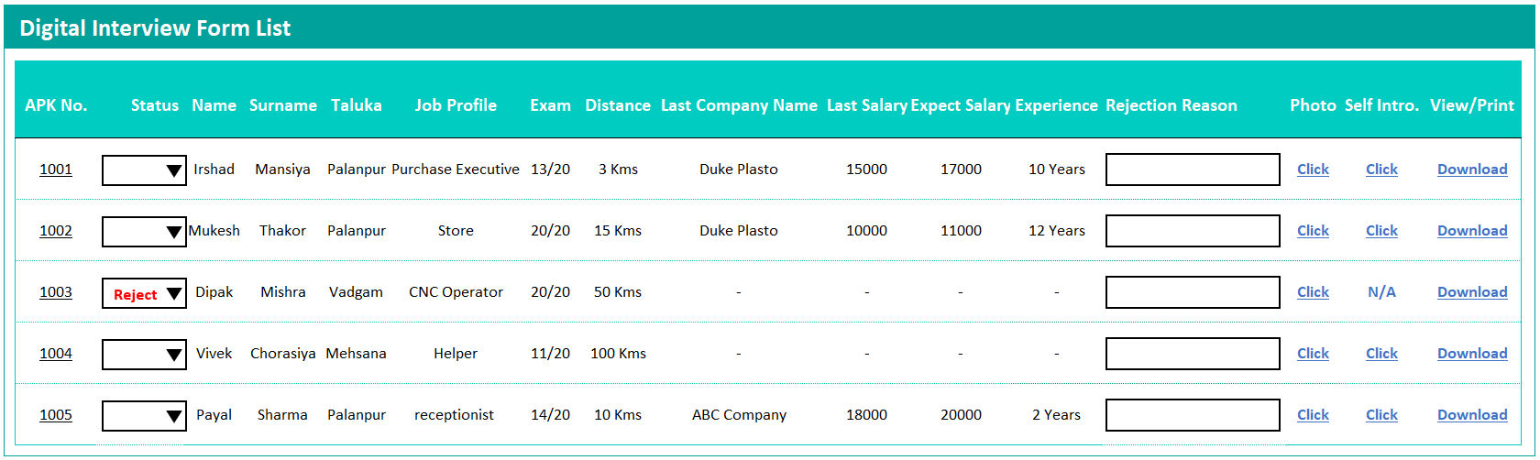
Digital Human Resource System “FIT TO JOB”
Initial Selection
Reject
Approved
Use this application no. as Unique no. and link with Punch no.
Submit

Slide 35
Digital Human Resource System “FIT TO JOB”
Initial Selection
Reject
Add Reason Compulsory
Submit

Slide 36
Digital Human Resource System “FIT TO JOB”
Initial Selection
Generate Call Later
Approved
Submit
Show only approved List

Slide 37


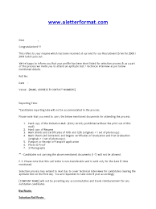
Digital Human Resource System “FIT TO JOB”
Inform to Candidate
Send Message and Mail to candidate with all details
Mail or Message
Submit Document
Print Interview Form

Slide 38
Digital Human Resource System “FIT TO JOB”
First Interview by HR
Document Check
Attached documents and original documents cross verification
Basic Question and Answer
Family background and past job history question and answer
Pass and Fail
If pass then go for second interview in same day and if Fail show remarks in report

Slide 39
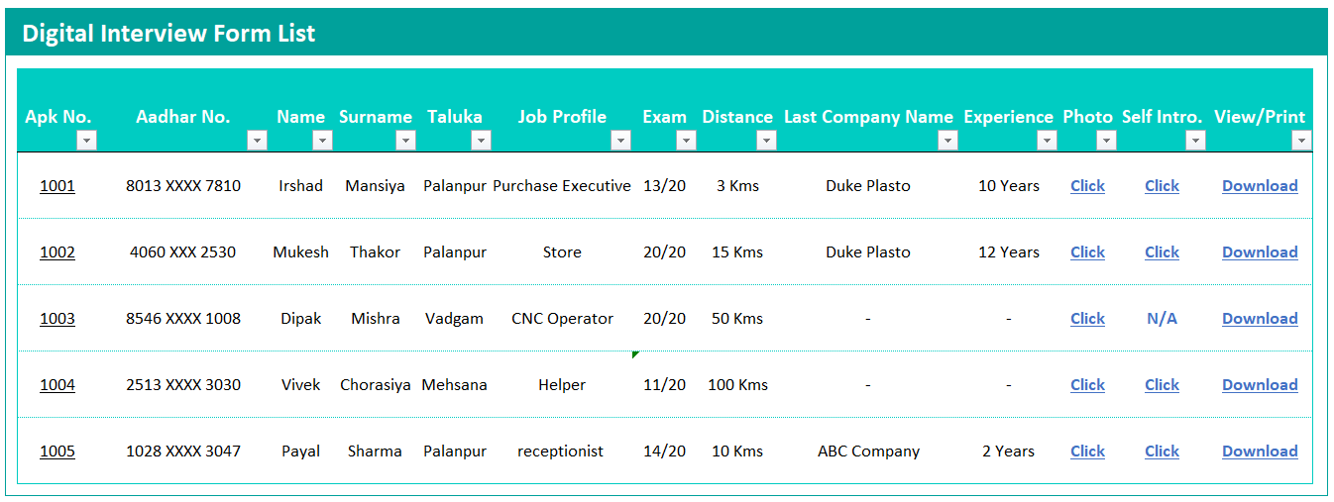
First Interview by HR
Interview Assessment
Click here for Interview Assessment
Show only approved candidate data

Slide 40
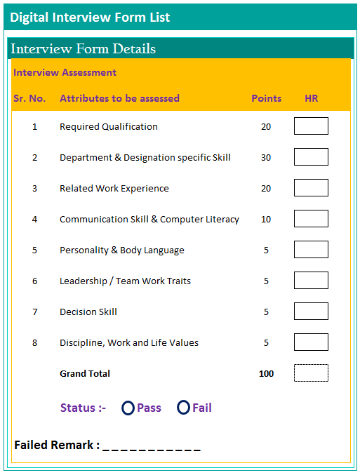
First Interview by HR
Header Details
Interview
Assessments
“ HR”
If “pass” go for Second Interview
Submit

Slide 41
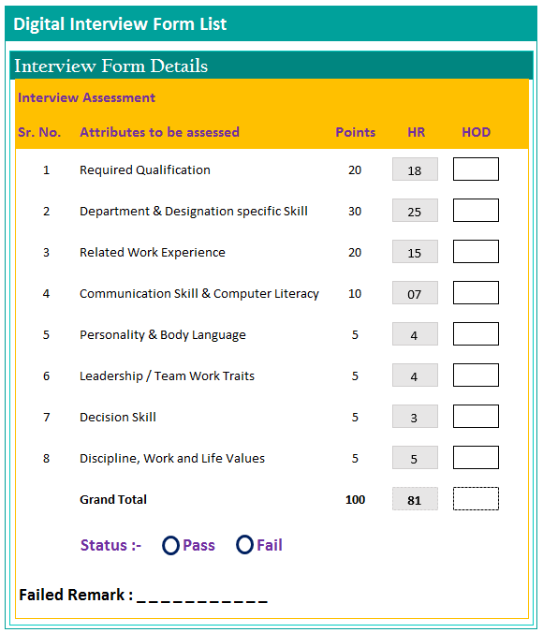
Second Interview
Header Details
Interview
Assessments
“ HOD/Mngm.”
If “pass” go for Final Activity
Submit

Slide 42
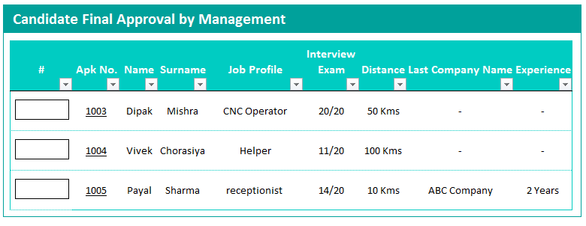
Final Management Approval
Approved
Disapproved
Hold
This list show after HR Final Approval
Show Candidate Full Details
Name
Job Profile
Interview Exam Marks
HR Assessment Marks
HOD Assessment Marks
Salary
Experience
Etc…

Slide 43
HR Activity
Send Offer Latter (Optional)
Pass Candidate List
Send Offer Latter
Accept
Select Job Profile
Go for further Process
Salary Decide

Slide 44
HR Activity
Send Appointment (Optional)
Pass Candidate List
Send Offer Latter
Decline
Select Job Profile
Reason
Salary Decide
Update Data in Interview List

Slide 45
HR Activity
Send Offer Latter (Optional)
Pass Candidate List
Send Offer Latter
Accept
Send Appointment Latter
Select Job Profile
Accept
Salary Decide
Job Offer

Slide 46
HR Activity
Send Offer Latter (Optional)
Pass Candidate List
Send Offer Latter
Accept
Send Appointment Latter
Select Job Profile
Decline
Salary Decide
Reason and update in interview form

Slide 47
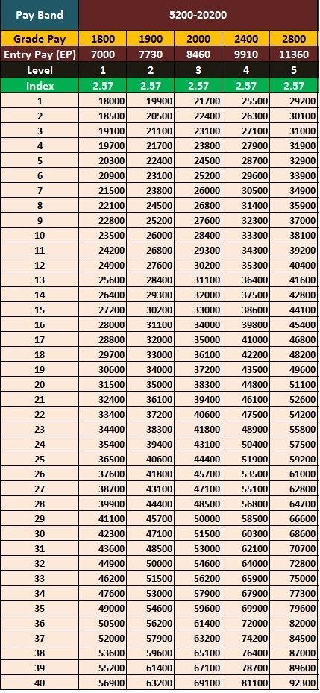
Job Offer
HR Activity
Pass Candidate List
Select Job Profile
Salary Decide
Select Salary From Table (Pay Scale)
Joining Date

Slide 48
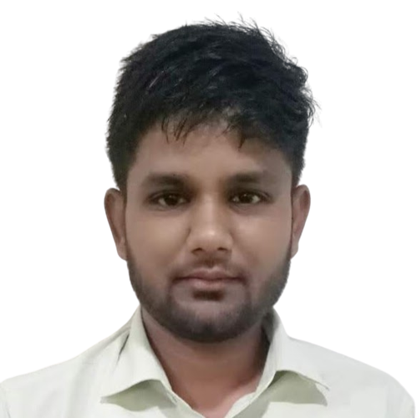
HR Activity
Generate Identity Card
Auto Identity Card
Show in HR Application
View, Print and Mail Option
Irshad Mansiya
Purchase Executive
Emp. Code – 977
Department – Purchase
Duke Plasto Technique Private Limited
Palanpur, Gujarat -385511, India

Slide 49
Digital Human Resource System “FIT TO JOB”
Job Offer
Option No. 1 “Kiosk”
Job Profile
HR Knowledge
Corporate Video
HR Rules
Company Rules & Regulation
Japanese Concept
ISO Manual
Gradation
Canteen Policy
ETC…
Joining Date
Basic Training 3 days
Option No. 2 “Web”
Training material auto provide by system according to Job profile.
Training material will arrange by training instruction in system.

Slide 50
Digital Human Resource System “FIT TO JOB”
Final Stage
Exam
Job Offer
Fail
Pass
Compare Report [Interview Asses. + After Training]
Add Reason
Salary Final
Allocate Punch No.
Link Interview Data With Punch No.

Slide 51
Digital Human Resource System “FIT TO JOB”
To be continue…
New employee to be treated as Regular employee

Slide 52
Duke Plasto Technique Private Limited
Existing Employee
Digital Human Resource System
“FIT TO JOB”

Slide 53
Digital Human Resource System “FIT TO JOB”
Flowchart of Fit to Job
Fit to job
Result
Question Bank
Fit to job
Dashboard
Fit to job
Fit to job
Exam Schedule
Fit to job
Fit to job
Fit to job
Fit to job
Fit to job
Fit to job
Fit to job
Pass Emp. Reward
Exam Type
Fit to job
Fit to job
Fit to job
Fit to job
Fail Emp. Training Plan
Exam
Fit to job
Fit to job
Fit to job

Slide 54




Digital Human Resource System “FIT TO JOB”
Flowchart Question Bank
Exam Type
4 type exam
Written, Practical
Video Exam, Promotions
Question Bank
Management Approved Question
Question Level
4 type level
Easy, Medium,
Hard, Challenging
Question Type
Option /MCQ Question
Image Selection Question
System /(Subject)
Subject wise Question
Question Review Option
Schedule of Question Revise
Ineffective Question Option
Rev. Reminder
Job Profile
Job Profile Wise Question
Like Standard

Slide 55
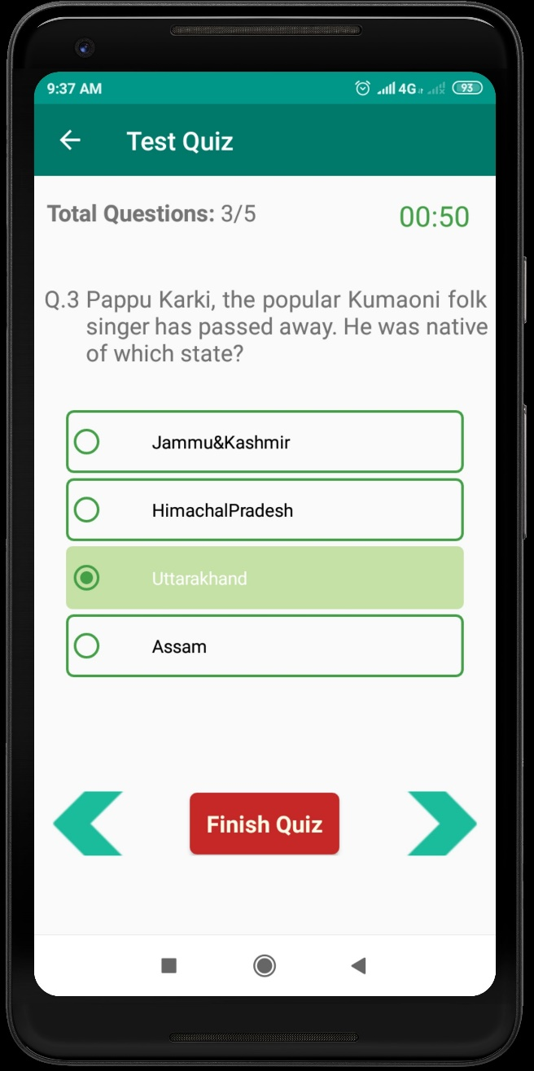
Digital Human Resource System “FIT TO JOB”
Question Type
MCQ Type
Image Selection Type

Slide 56
Interview Details
Select Job Profile
State GM Leader
Executive
Ask for Which Area
Marketing Staff
Security
Canteen
Sweeper
Utility Staff
Select Job Profile
Purchaser
Accountant
Design
System
IT
HR
Admin
PPC
Office Staff
Production Leader
Winder
Fitter
Helper
Store Keeper
QC inspector
Welder
CNC Operator
Lath Operator
Press Operator
Production Staff
Note :- Multiple job profile selection option and show all job profile

Slide 57






Digital Human Resource System “FIT TO JOB”
System (Subject)
Post / Job Profile
System (Subject)
Work Instruction
HR
Safety
Japanese Concept

Slide 58
Digital Human Resource System “FIT TO JOB”
System (Subject) Details
Material Identification
Instrument Selection
Measurement
Program Selection
Machine/Computer Operating
Report/Drawing Reading
Work Safety
Material Safety
Human Safety
ETC…
Work Instruction
Safety
Kaizen
OEM
Take Time
Etc…
HR
Basic / Gross / CTC Salary
EPF
Gratuity
Etc…
Japanese Concept

Slide 59
Digital Human Resource System “FIT TO JOB”
Question Level
First
Quarter
Easy Question
Second
Quarter
Medium Question
Third
Quarter
Hard Question
Fourth
Quarter
Challenging Question

Slide 60
Digital Human Resource System “FIT TO JOB”
Type of Exam
Exam Type
Written
Practical
Optional
Self Learning
Optional
Promotion

Slide 61
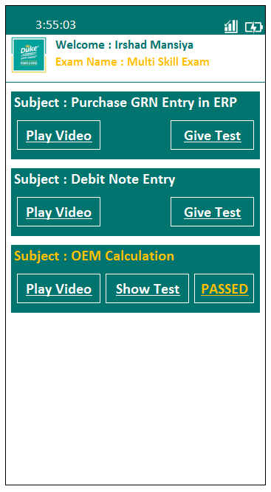
Digital Human Resource System “FIT TO JOB”
Type of Exam
Multi Skill Exam
Promotion Exam

Slide 62
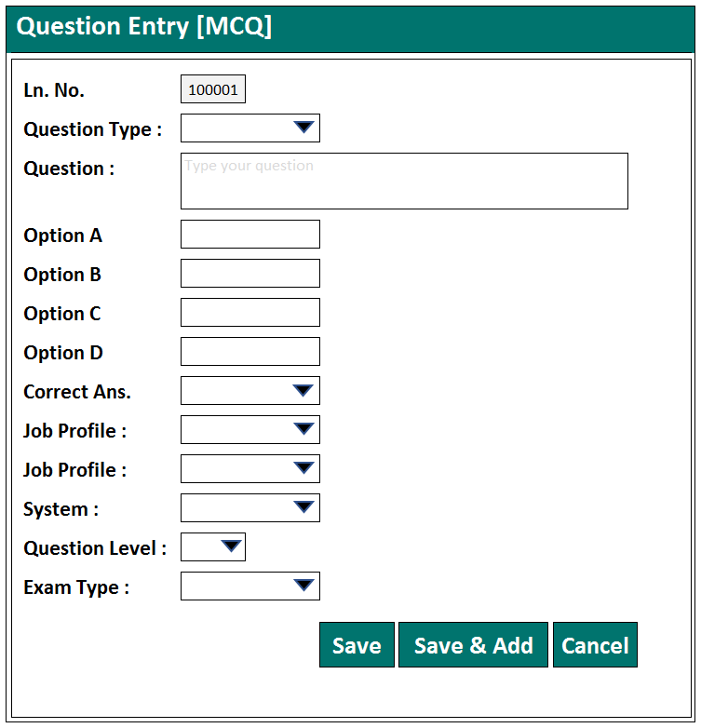
Digital Human Resource System “FIT TO JOB”
Question Entry [MCQ]

Slide 63
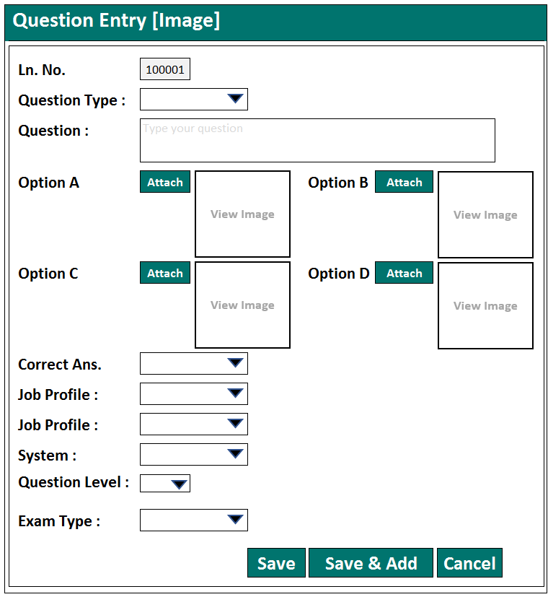
Digital Human Resource System “FIT TO JOB”
Question Entry [Image]

Slide 64
Digital Human Resource System “FIT TO JOB”
Exam Schedule
Job Profile :
CNC Operator
Select from list
System :
5S
Select from list
Question Level :
Easy
Auto as per Quarter
Exam Type :
Written
Option : Written or Practical
Assign Exam invigilator :
Mr. Savjibhai
Select Manual
Total Question :
20
Qty : Select Manual,
Question : System auto select from Bank
Total Marks :
20 Marks
Select Manual
Select Employee :
05 Employee
Option : Auto and Manual
Schedule – Date :
30-Sep-2022
Manual
Schedule – Time :
09:00 AM
Manual
Note :- For new employee start exam with easy question and also manual option for select exam type

Slide 65
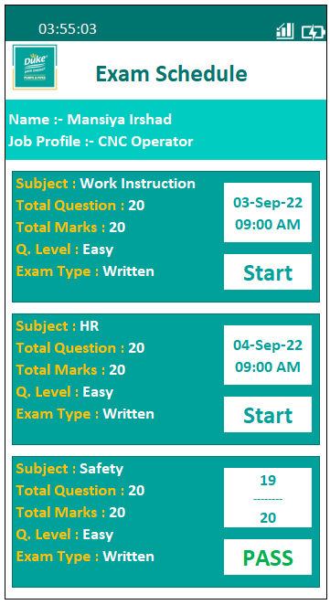
Digital Human Resource System “FIT TO JOB”
Exam Schedule

Slide 66
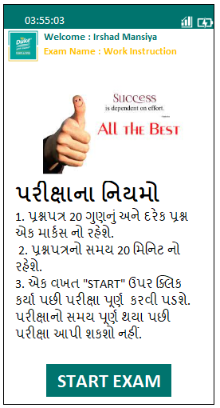
Digital Human Resource System “FIT TO JOB”
Exam

Slide 67
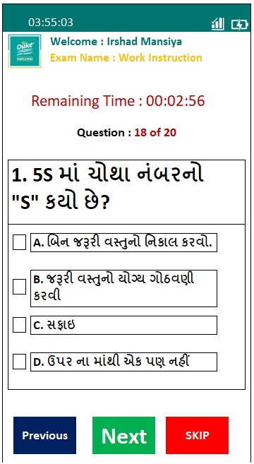
Digital Human Resource System “FIT TO JOB”
Exam

Slide 68
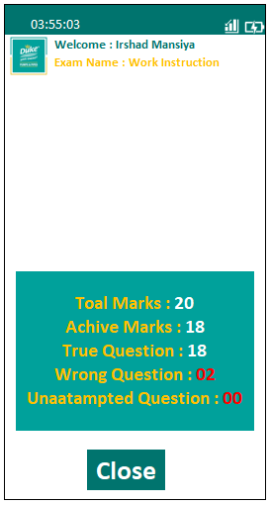

Digital Human Resource System “FIT TO JOB”
Exam
You are Passed

Slide 69
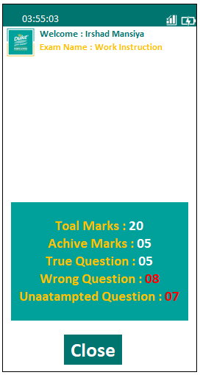

Digital Human Resource System “FIT TO JOB”
Exam
You are Failed

Slide 70





Digital Human Resource System “FIT TO JOB”
Pass
Certificate
Award
Exam
Result
Fail
Set Subject Wise weightage’s
Like :- HR marks High but Work Instruction marks is Low
Training Plan
Training Record
Re-Exam

Slide 71
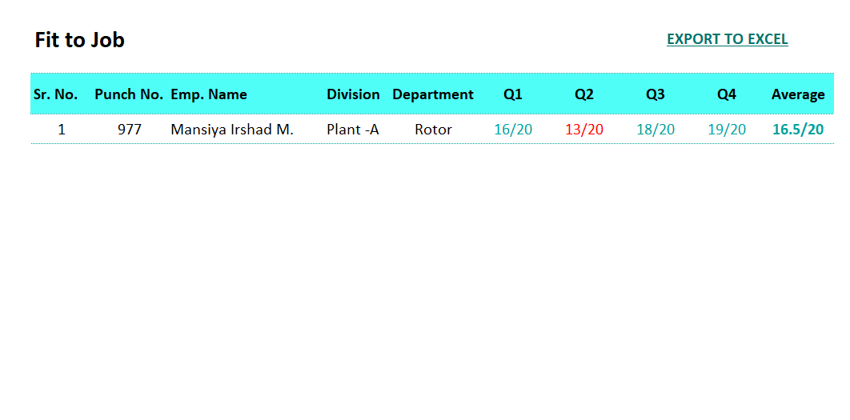
Digital Human Resource System “FIT TO JOB”
Dashboard
Digital iHR System
Fit to Job
Plant – A
Pass = 36
Fail = 10
Pending = 05
Plant – B
Pass = 30
Fail = 11
Pending = 08
Plant – C
Pass = 20
Fail = 08
Pending = 16
HO
Pass = 28
Fail = 03
Pending = 00
Marketing
Pass = 18
Fail = 10
Pending = 20

Slide 72
Digital Human Resource System “FIT TO JOB”
Dashboard
Digital iHR System
Fit to Job
Plant – A
Pass = 36
Fail = 10
Pending = 05
Plant – B
Pass = 30
Fail = 11
Pending = 08
Plant – C
Pass = 20
Fail = 08
Pending = 16
HO
Pass = 28
Fail = 03
Pending = 00
Marketing
Pass = 18
Fail = 10
Pending = 20
Quarter Wise Fit to Job
1st Quarter
Pass: 08
Fail : 02
2nd Quarter
Pass: 08
Fail : 02
3rd Quarter
Pass: 10
Fail : 00
4th Quarter
Pass: 10
Fail : 00

Slide 73
Digital Human Resource System “FIT TO JOB”
Dashboard
Digital iHR System
167 – Barot Sanjay 98
157 – Govinda Mahendra 89
570 – Joshi Sunil D. 88
Fit to Job Top 10 Employee
Unfit to Job Top 10 Employee
167 – Barot Sanjay 58
157 – Govinda Mahendra 47
570 – Joshi Sunil D. 32
Pending Interview List
525
Other Exam Passed
30
Promotion Exam Passed
03
Quarter Wise Exam Paper
15

Slide 74
Digital Human Resource System “FIT TO JOB”
Dashboard
Digital iHR System
PLANT - A
Fit to Job
Un-qualified Training Plan
Pass
56
Fail
10
Pending
10
Attend
56
Pending
10
Unattended
10
Quarter Wise Fit to Job
1st Quarter
Pass: 08
Fail : 02
2nd Quarter
Pass: 08
Fail : 02
3rd Quarter
Pass: 10
Fail : 00
4th Quarter
Pass: 10
Fail : 00

Slide 75






Digital Human Resource System “FIT TO JOB”
Other Reports
Reports
Pass / Fail Report
Pass / Fail Report
Quarter/Year Wise
Subject Wise
Wrong Answer Summary
Summary / Details Reports

Slide 76
Digital Human Resource System “FIT TO JOB”
Internal Recruitment
Show List Who passed Promotion and Multiskilled Exam
First Interview by HR
HR Assessment
Select Employee
Inform to Candidate
Message | E-mail
Select Job profile
Second Interview by
Select Interview Date and Time
Change Job Profile
if Pass

Slide 77
Digital Human Resource System “FIT TO JOB”
Family Background Data
Decide Template
Retention period
Help for Promotion
Family Background Details
Reports

Slide 78
“FIT TO JOB”
Backups Plan
Autonomous system.
HR Executive and Happiness Manager are responsible
Maintain and evaluate data
Instructor responsible for Current employee FTJ
Gape Finding
Training Plan
Training
Re-exam

Slide 79
“FIT TO JOB”
Benefits
of Fit to Job Digital Human Resource System
From very first day productive employee
24/7 interview
Skill person interview
Choisable interview
Recruitment justification
Find right candidate - Right employee Right Job
Reduce hidden expenses
Remove wrong selection
Skill & Fit to job improve
Self responsible employees

Slide 80
“FIT TO JOB”
Benefits
of Fit to Job Digital Human Resource System
Self reliable employee
Replace unFTJ employees
Independent employees
Multi skill employee
Employee growth plan
Employee Vision clear
Employee wise training plan
Employee wise FTJ growth
Data Management Tool

Slide 81
Digital Human Resource System “FIT TO JOB”
Benefits
of Fit to Job Digital Human Resource System
Paper less activity
Remove Data loss problem
Autonomous update
Advance system
Data autonomous
Reduce Expense

Slide 82
Thank You

Slide 84
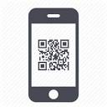

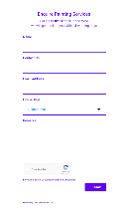

New Employee Exam Module
Barcode Scan
Login with OTP
Name Details
Job Profile
Exam
Feedback
Result

Slide 85


Digital Suggestion Module
Digital Suggestion
Select Job Profile
Type Suggestion

Slide 86




Digital Human Resource System
Post / Job Profile
Press Operator
Halper
Data Entry
Store Keeper

Slide 87

Fit to Job Module
Question Level
First Quarter
Fourth Quarter
Easy Question
Challenging Question
Second Quarter
Third Quarter
Medium Question
Hard Question

Slide 88

Fit to Job Module
Post / Job Profile
Subject
Question Bank

Slide 89
Fit to Job Module
Question Bank
Post / Job Profile Wise
Question Level
Post / Job Profile Wise
Subject Wise

Slide 90
Fit to Job Module
Post / Job Profile
Subject
Question Bank
Question Level

Slide 91

Fit to Job Module
Schedule
Post / Job Profile
Subject
Exam Type
Question Level
Question Bank

